Slide 1
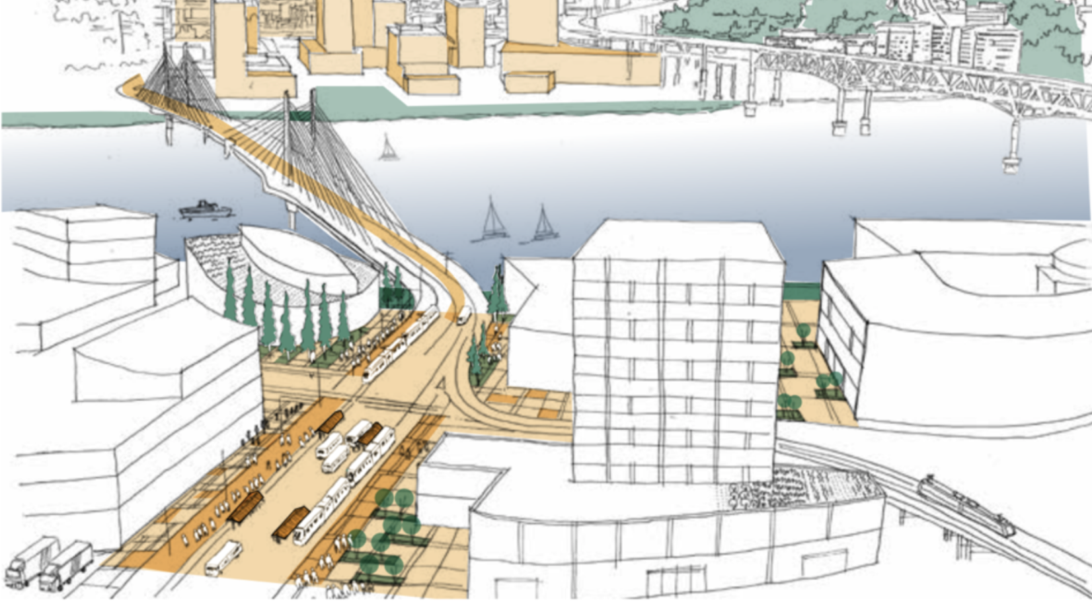
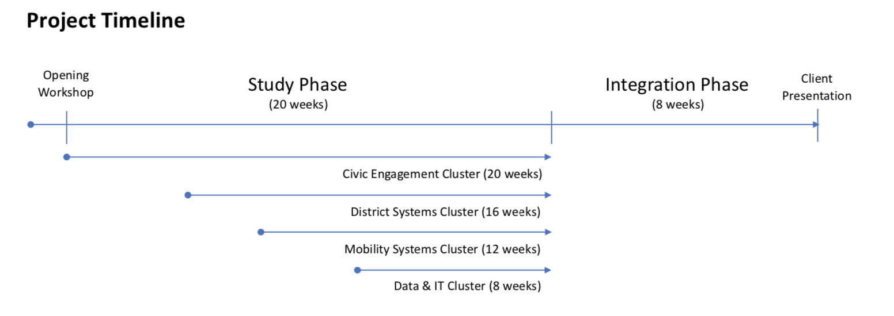
OMSI Infrastructure: scaling Bullitt Center (node) … kickoff STUDY
INFRACENTER
Story-by-story...
ENERGY-as-a-SERVICE
MOBILITY-as-a-SERVICE
DATA-as-a-SERVICE
PLACEMAKING: green-building (verb)

Slide 2
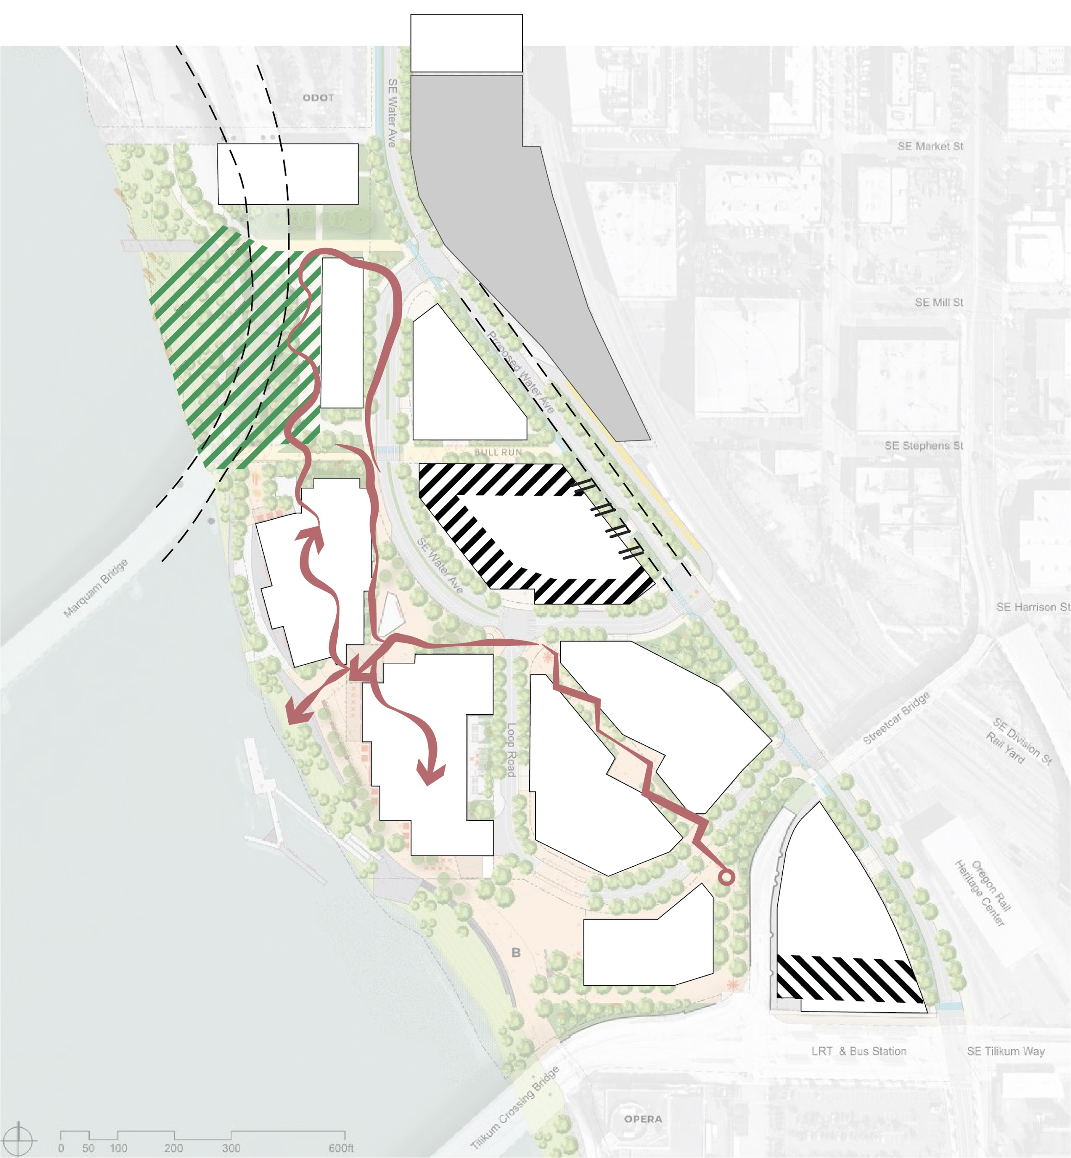
SCENARIO 1
PCC CLIMB CENTER
Story-by-story...
CREATIVE OFFICE SPACE
FUTURE ROAD
CONSTRUCTED WETLANDS
(EDUCATIONAL EXHIBIT)
CENTRAL UTILITY PLANT
OMSI MAKER SPACE
RESIDENTIAL
OFFICE
STREETFRONT SHOPS
RIVER VIEWS AND ACCESS
RESIDENTIAL
OFFICE
DISTRICT PARKING

Slide 3
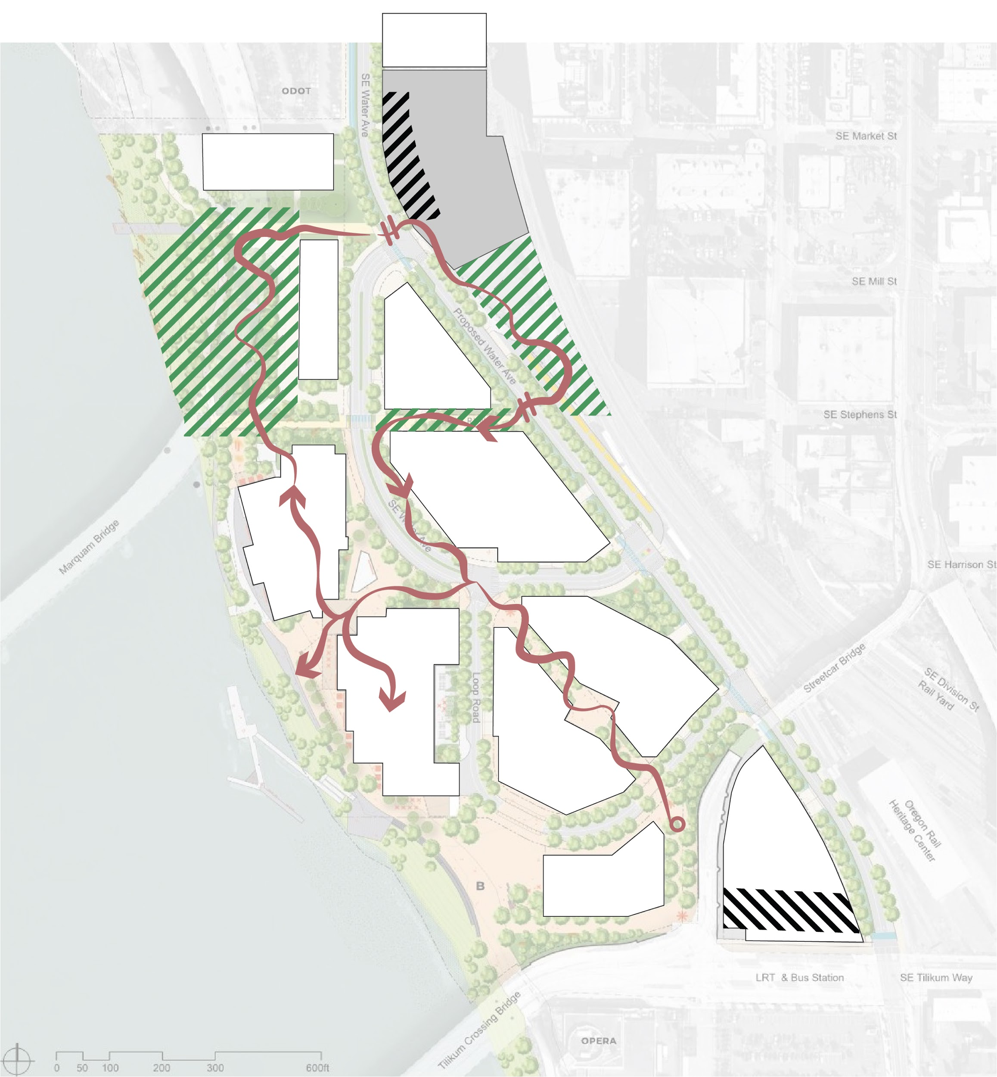
SCENARIO 2
PCC CLIMB CENTER
Story-by-story...
DISTRICT PARKING GARAGE
CREATIVE OFFICE SPACE
DISTRICT BICYCLE PARKING
WASTEWATER TREATMENT
FUTURE ROAD
CONSTRUCTED WETLANDS
(EDUCATIONAL EXHIBIT)
RIVER VIEWS AND ACCESS
OMSI MAKER SPACE
RESIDENTIAL
OFFICE
STREETFRONT SHOPS
DISTRICT PARKING

Slide 4
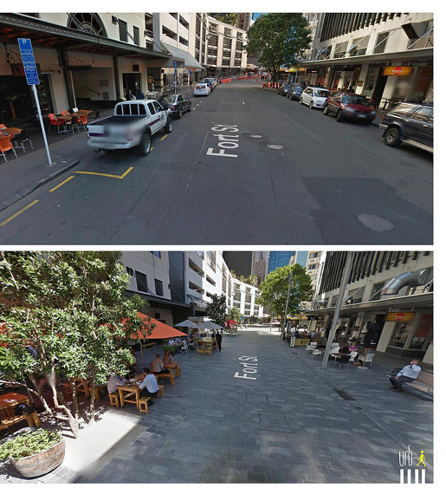
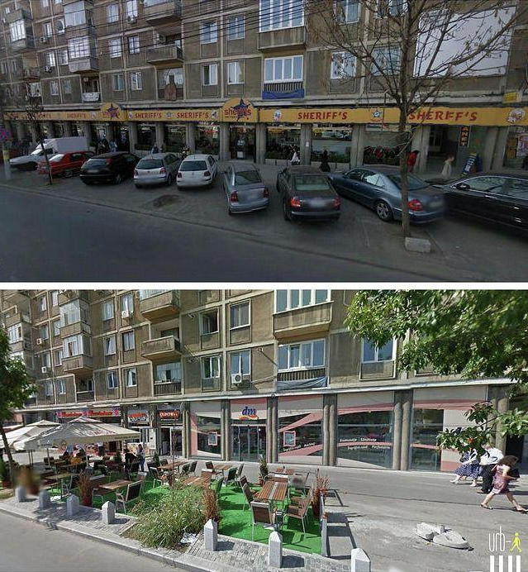
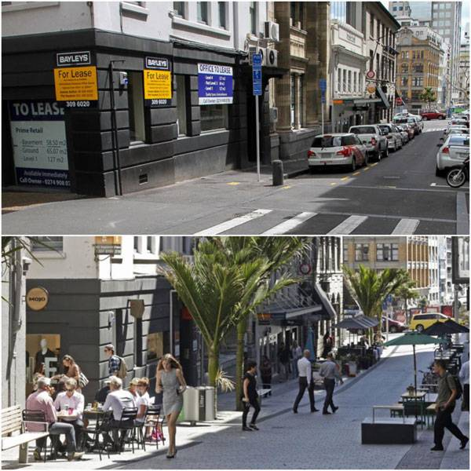
“tactical urbanism”… parking->choices?
Placemaking...
BEFORE
AFTER
13

Slide 5
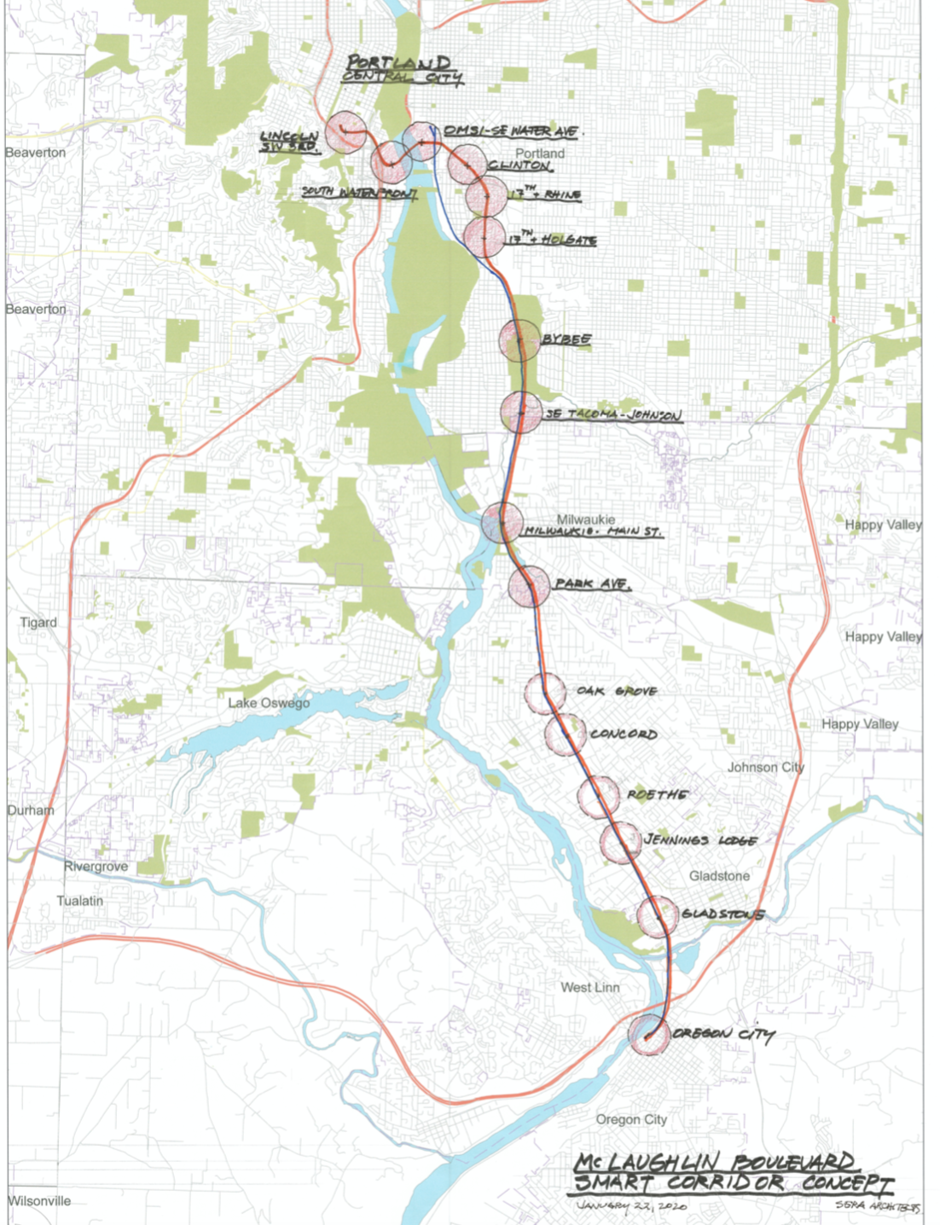
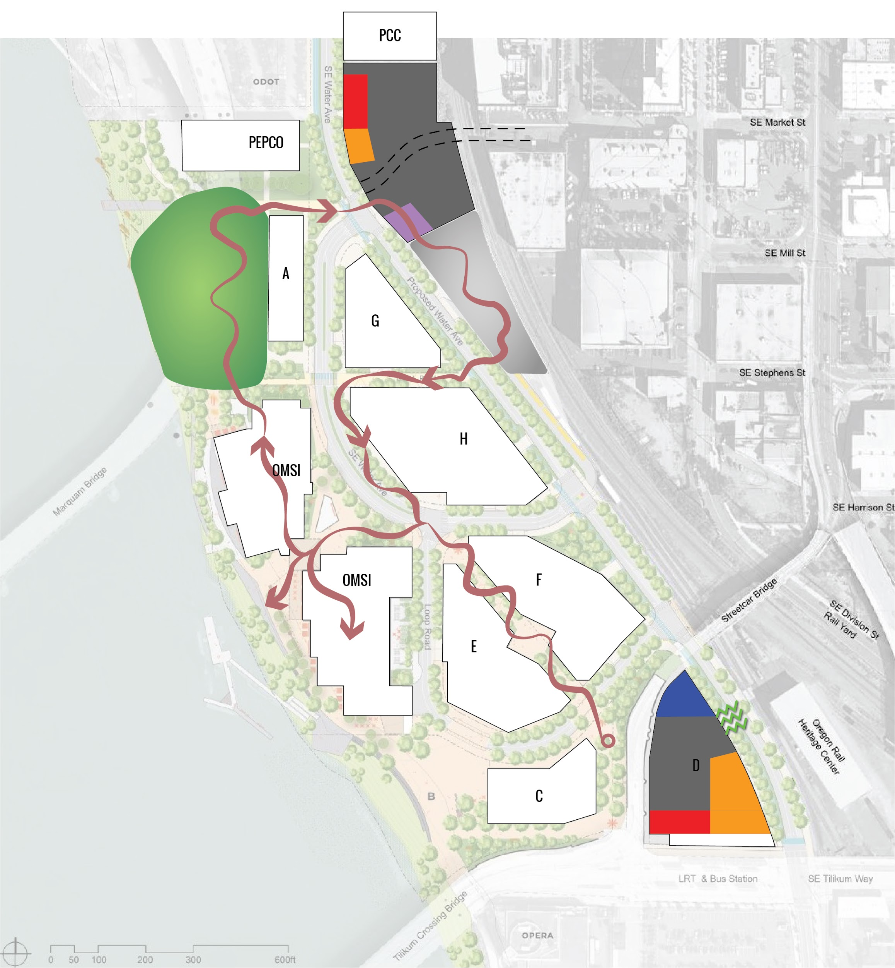
Decision Theater
Story-mapping...
Room is 37’ x 27’
“digital-twin”
15

Slide 6
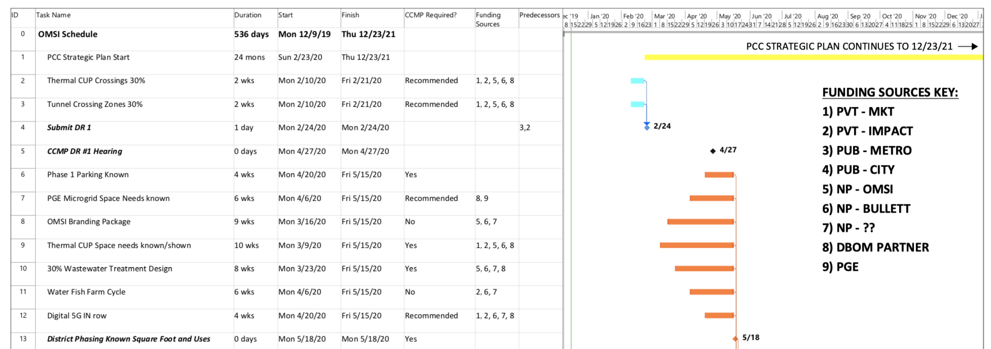
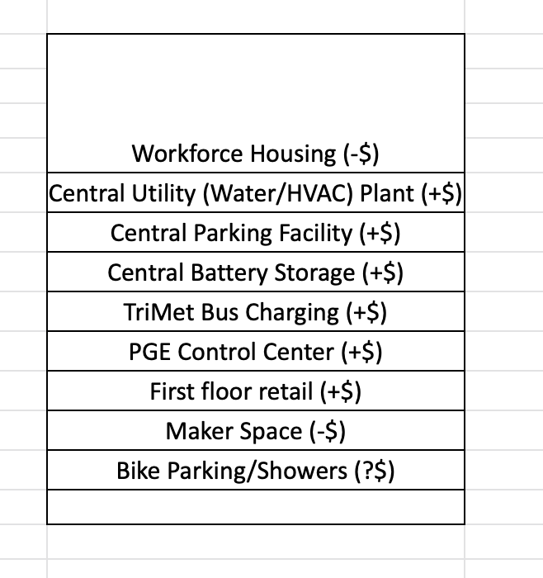
COMMUNITY Development program – step-by-step:
Public+Private: PARTNERS
FUNDING: “the stack”
20

Slide 7
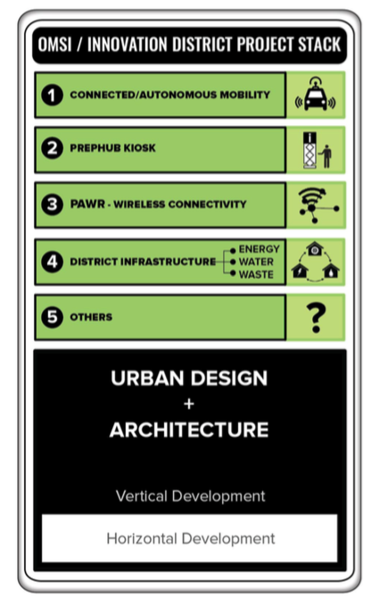
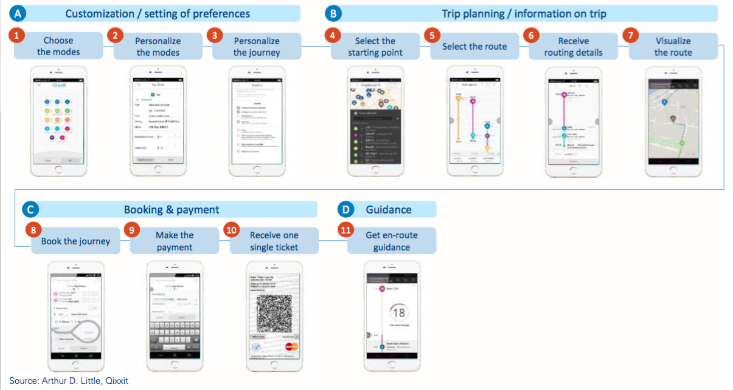
PLAN: a Community Engagement program?

Slide 8
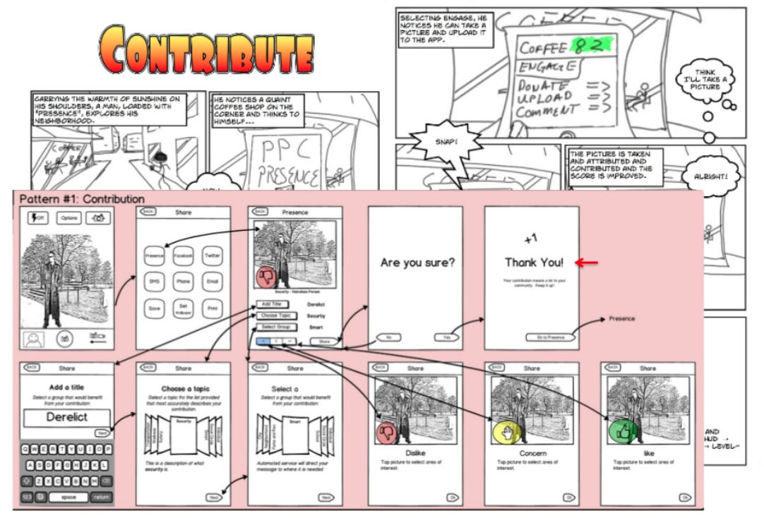
TEST: “digital-twin”
19

Slide 9
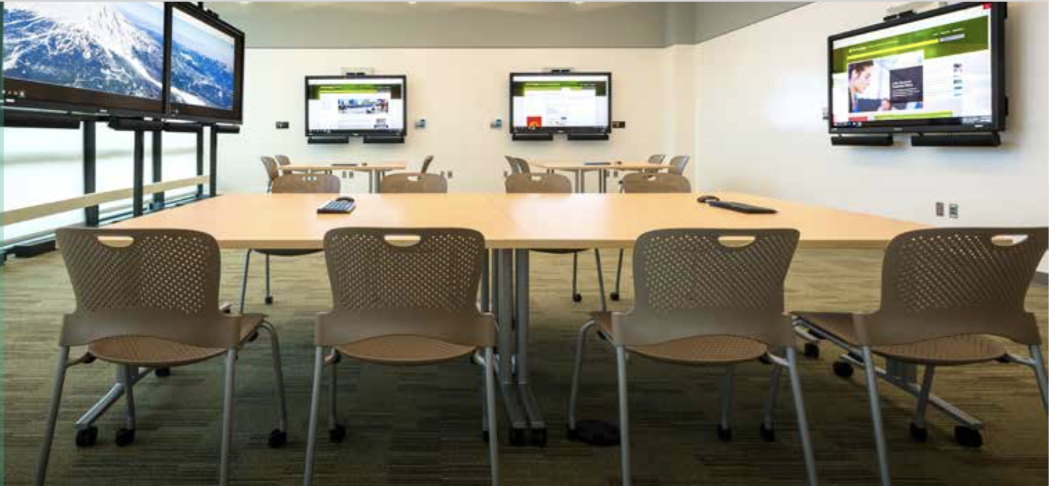
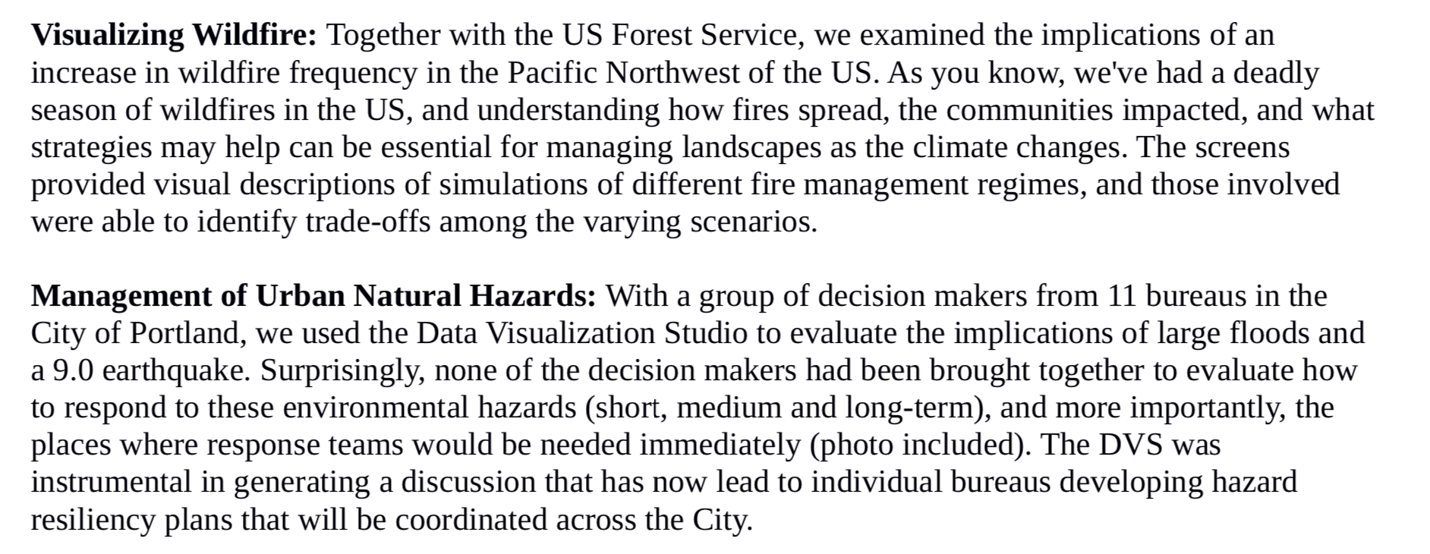
TEST: “digital-twin”

Slide 10
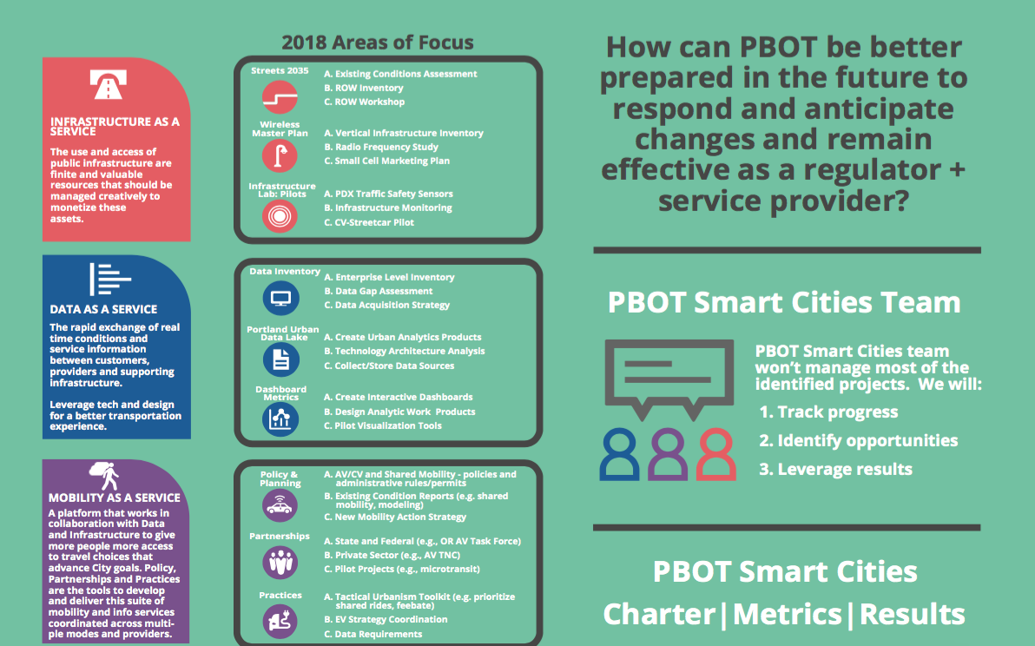
PBOT: “digital-twin”

